Slide 1
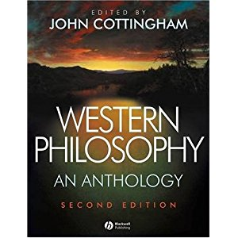

Slide 3
Introduction to Philosophy
Plato’s Republic
Greek Philosophy
Socrates
Socratic Method:
Admit ignorance.
Never rely on tradition.
Continuously question.
Formulate your own opinions.
Test your opinions with others.

Slide 4
Introduction to Philosophy
Plato’s Republic
Greek Philosophy
Plato
The Republic
In the book's dialogue, Socrates discusses the meaning of justice and whether or not the just man is happier than the unjust man with various Athenians and foreigners.
They consider the natures of existing regimes and then propose a series of different, hypothetical cities in comparison. This culminates in the discussion of a hypothetical city-state ruled by a philosopher king.
They also discuss the theory of forms, the immortality of the soul, and the role of the philosopher and that of poetry in society.
The dialogues may have taken place during the Peloponnesian War.

Slide 5
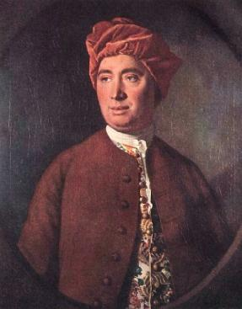
Introduction to Philosophy
Hume’s Standard of Taste

Slide 6
Introduction to Philosophy
Hume’s Standard of Taste
David Hume
1711 – 1776
Scottish
radical philosophical empiricism, skepticism, and naturalism
British empiricist (with John Locke, Francis Bacon, and Thomas Hobbes)
Hume held that knowledge must either be directly traceable to objects perceived in experience, or result from abstract reasoning about relations between ideas which are derived from experience
Hume's anti-teleological opposition to the argument for God's existence from design is generally regarded as the most intellectually significant such attempt to rebut the teleological argument
sentimentalist: ethics are based on emotion or sentiment rather than abstract moral principle, famously proclaiming that "Reason is, and ought only to be the slave of the passions".
no actual conception of the self, we experience only a bundle of sensations, and the self is nothing more than this bundle of causally-connected perceptions

Slide 7
Introduction to Philosophy
Hume’s Standard of Taste
Nothing is in the intellect that was not first in the senses
The mind at birth is a blank slate, a tabula rasa
Hume’s statement of empiricism:
All simple ideas are copies of impressions
Complex ideas may be copied from or constructed out of impressions

Slide 8
Arguments for empiricism
Introduction to Philosophy
Hume’s Standard of Taste
Counterfactual dependence
Those who don’t undergo the relevant experiences don’t acquire the relevant concepts
Analyzability
All legitimate complex concepts can be analyzed into simple concepts

Slide 9
Against Descartes
Introduction to Philosophy
Hume’s Standard of Taste
We can be mistaken about what we’re thinking
it’s easier to be mistaken about ideas than impressions, since they’re less vivacious
Descartes is wrong to think there are pure ideas of the understanding. All ideas are ideas of the imagination
It follows that we cannot think about something we couldn’t experience!

Slide 10
Belief in causation comes from experience
Introduction to Philosophy
Hume’s Standard of Taste
We only experience correlations: A is constantly conjoined with B
We never experience a causal connection between them

Slide 11
Introduction to Philosophy
Hume’s Standard of Taste
Of the Standard of Taste was a seminal essay on aesthetics that is innovative because it requires Hume to address the apparent relativity of taste, a conclusion that follows from his own assumption that the "good" or "beauty" of a good work of art is identical with the positive human responses it generates.
The essay's focus on the subject (the viewer, the reader) rather than the object (the painting, the book) is typical of the British "sentimentalists" or moral sense theorists of the eighteenth century.
Hume begins with the observation that there is much variety in people's taste (or the aesthetic judgments people make).
However, Hume argues that there is a common mechanism in human nature that gives rise to, and often even provides justification for, such judgments. He argues that this still leaves room for the ability to refine one's aesthetic palate.
Hume took as his premise that the great diversity and disagreement regarding matters of taste had two basic sources - sentiment, which was to some degree naturally varying, and critical facility, which could be cultivated. Each person is a combination of these two sources, and Hume endeavours to delineate the admirable qualities of a critic, that they might augment their natural sense of beauty into a reliable faculty of judgment.

